Slide 1
IoT Security

Slide 2
Overview
Examine IoT security challenges
Building security IoT system
Review principles of IoT system

Slide 3
Case study
In late September 2016, most of the East Coast of the United States suffered almost complete Internet downtime in an attack by a group of systems called the Mirai botnet
The Mirai botnet was made up of 100,000 IoT devices, mainly CCTV cameras that were taken over by attackers to create a distributed denial of service (DDoS) attack of at least 620 Gbit/s.
This attack demonstrates a few of the core concerns of IoT security

Slide 4
Boundaries
The Internet of Things is enlarging the attack surface, and in many cases introducing weaker points of attack
A vast numbers of cheap devices connecting the physical world to the Internet, this enhanced attack surface we need to change to a different model where security is based on identity and trust, not on boundaries (as using firewall or checkpoint)

Slide 5
Privacy
IoT is a significant threat to privacy because IoT devices can be used to collect personal information.
Another key concern around IoT privacy and security is big data, misuse of big data.

Slide 6
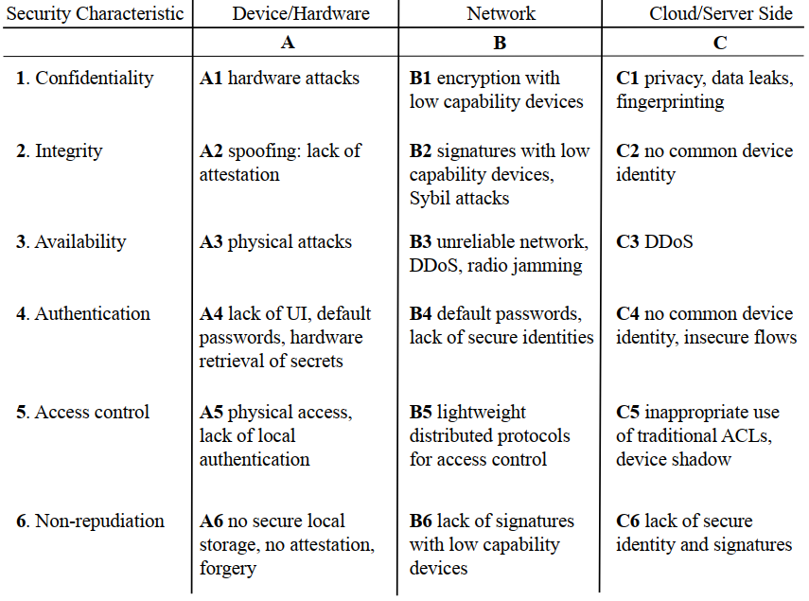
Challenges

Slide 7
Building Secure IoT Systems
OAuthing is an opensource research project that provides some of the key aspects that we need to protect the system
The code for OAuthing is available at https://github.com/pzfreo/oauthing
The aim of the OAuthing model is to create a secure system, with secure devices and a secure cloud service, together with a secure network between the two

Slide 8
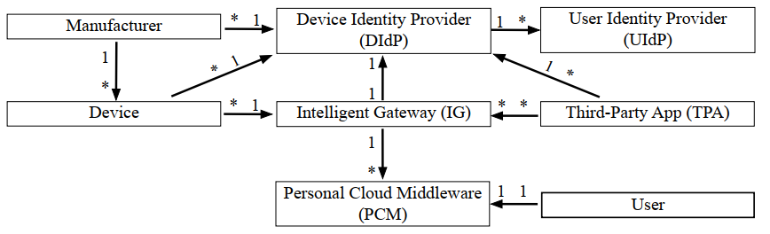
OAuthing
Notes:
Arrows denote relationships, 1: one, *: many.

Slide 9
PRINCIPLES OF IOT SECURITY
Don’t rely on obscurity.
Each device needs unique secure credentials.
Support simple update procedures
Only support device update if you can secure it
Publish just enough data and no more
Ensure that there is consent for all data sharing or command sharing

